Slide 1


Development of an optimized opioid misuse prevention program for at-risk employees
Scarlett Ruppert, MPH, GracieLee Weaver, PhD,
Stephen Hebard, PhD, Bill Hansen, PhD, Jeffrey Milroy, DrPH, David Wyrick, PhD
INEBRIA
September 2023
preventionstrategies.com
athletewellness.uncg.edu
Notes:
The development of the opioid misuse prevention program is part of an SBIR project funded by NIDA and the conceptual model presented here – as a guide for future program development and research. We also present results of a funded pilot project with the Carolina Center for Healthy Work Design and Worker Wellbeing to examine future implications for opioid misuse prevention programming.

Slide 2


Opioid Misuse Among Workers
70%
85%
¼
More than half
of pain meds prescribed are opioids
of accidental opioid overdoses occur after a work injury
of employers
Only ¼
report offering any programming on opioids
of those prescribed opioids misuse them
report negative consequences
Notes:
Employees in industries with high rates of opioid dispensing and non-fatal work related injury (construction, healthcare, etc.) are at increased risk for opioid misuse. Workplace costs associated with opioid misuse is estimated at $25.6 billion due to lost productivity, turnover, and premature death of employees. The growing presence of the opioid crisis in the workplace brings to light the need for more evidence-based interventions to prevent opioid misuse among at-risk employees.

Slide 3
Multiphase Optimization Strategy (MOST)
Evaluation
Phase
Preparation Phase
Optimization Phase
Develop conceptual model
Identify components for prototype
Pilot test
Plan for next phase
Conduct factorial optimization trails
Build all intervention components
RCT to confirm effectiveness of optimized intervention
Notes:
Our team used a multiphase optimization strategy (MOST) to develop, test, and optimize an opioid misuse prevention program tailored for workers in high risk industries.
We are currently in the optimization phase but are presenting results from the preparation phase here.

Slide 4
Healthcare Workers
74.9%
56%
reported having used prescription opioids
reported pain every day for a week or more in the last 12 months
Among the most injured workforces
Notes:
In a NIOSH analysis of BLS data for the years 2011 to 2016, 43% of drug overdose deaths at work occurred in only three industries – Construction, Healthcare, and Transportation & Warehousing
Nurses are among the most injured workforces just behind construction workers
Results from our phase 1 data supported prior research that healthcare workers experience frequent pain.

Slide 5
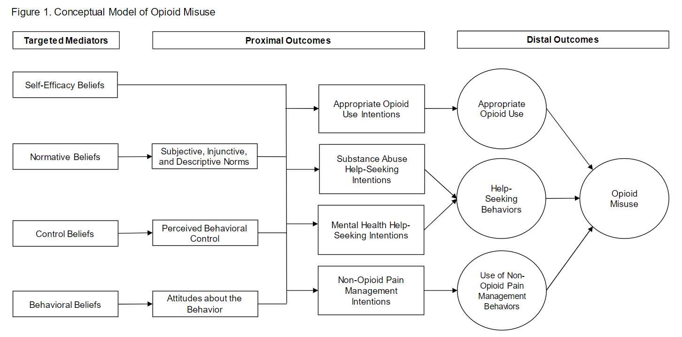
Conceptual Model
Notes:
Model that guided initial prototype development
Mention that expert panel members provided feedback to iterations of the conceptual model prior to program planning

Slide 6
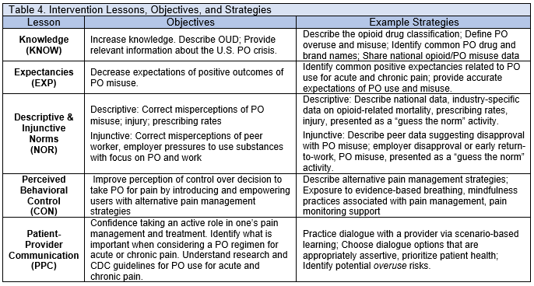
WorkWell Prototype Lessons
Notes:
The WorkWell prototype was developed as a mobile friendly web based intervention that would be offered through a mobile app. Ideally, participants would be able to access the intervention via short interaction (approximately 5 minutes) and complete the entire intervention in these small doses over a longer period of time. However, for the ease of testing this intervention, the WorkWell prototype was completed by participants in one sitting that took approximately 1.5 to 2 hours.
Phase 1 addressed individual and interpersonal level predictors – based on TPB, Theory of Reasoned Action, and prior research conducted with other substance misuse

Slide 7
WorkWell Prototype Results
  + knowledge of opioids
  - positive attitudes towards opioids
  + communication with providers
  + pain management control
  + intentions to avoid opioid use
Notes:
Using repeated measures ANOVA to test changes from pre to post with 34 healthcare workers
All constructs presented here were scales created from multiple items with likert response options (e.g. using opioids for pain management, using to work through pain) regarding good/bad, important/unimportant, pleasant/unpleasant
Results used to inform Phase 2 development and testing of the WorkWell Program

Slide 8
WorkWell Prototype Feedback
Over 90%
agreed that others in their industry should complete a program like this
felt the program was easy to understand
did not feel distracted while completing the program

Slide 9
Next Steps for Development & Testing
Evaluation
Phase
Preparation Phase
Optimization Phase
Develop conceptual model
Identify components for prototype
Pilot test
Plan for next phase
Conduct factorial optimization trails
Build all intervention components
RCT to confirm effectiveness of optimized intervention
Notes:
Knowledge, beliefs/attitudes, norms, behavioral control, patient-provider communication, alternative pain management
For all of the intervention components, we are fully developing content and delivery method which will be an app accessible on web or mobile phone – then during optimization phase, each participant recruited will be randomly assigned to different combinations of intervention components using a factorial approach. This means much bigger sample size to test each combination of intervention components. This will allow us to compare and determine effectiveness of each component and eventually narrow down to include only effective components for the final evaluation phase of the project.
We tested initial phase 1 with heatlhcare workers only, but for optimization we are expanding this to include construction workers.

Slide 10
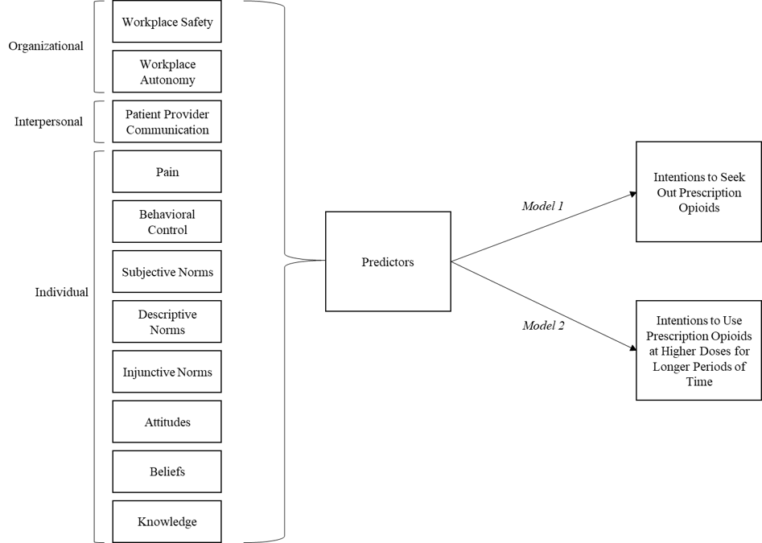
Workplace Level
Predictors of Misuse Intentions
Notes:
With pilot funding from the Carolina Center for Healthy Work Design & Worker Wellbeing, we used data collected from 856 healthcare workers to examine predictors of intentions for misuse while applying a Social Ecological lens – an attempt to determine whether workplaces would benefit from additional intervention aside from our WorkWell program targeted at individuals.
We tested the effects of individual, interpersonal, and organizational level predictors on two intention outcomes: intentions to seek out prescription opioids and intentions to use at higher doses for longer periods of time than prescribed.
Linear regression models were used to assess pathways of the hypothesized conceptual model, including the potential mediation of intentions to seek out prescription opioids. Model 1 tested the relationship between predictor variables on intentions to seek out prescription opioids. Model 2 tested the relationship between predictors and intentions to use higher doses for longer periods of time. Demographic variables were included as controls in both regression models. VIFs were used to assess multicollinearity of the models.

Slide 11
Multi-level Predictors of Misuse
On intentions to seek out prescription opioids, no significant effects aside from individual level predictors
On intentions to use higher doses over longer times, patient-provider communication, workplace safety, and workplace autonomy had significant protective effects
Notes:
Survey results from 856 healthcare workers during the preparation phase supported our conceptual model, showing significant effects of knowledge, beliefs, attitudes, social norms, perceived behavioral control, and patient-provider communication on intentions to misuse prescription opioids.
Model 1 shows a significant negative effect of Beliefs (B = -0.196, p<0.001), Injunctive norms (B = -0.134, p=0.001), Subjective Norms (B = -0.104, p=0.013), and Behavioral Control (B = -0.634, p<0.001) on intentions to seek out prescription opioids.
Model 2 shows a significant protective effect of Knowledge (B = -0.099, p=0.008), Beliefs (B = -0.129, p=0.001), Behavioral Control (B = -0.186, p<0.001), Patient-Provider Communication (B = -0.573, p<0.001), Workplace Safety (B = -0.077, p=0.017), and Workplace Autonomy (B = -0.130, p<0.001) on intentions to use higher doses over longer times.

Slide 12
Future Directions
Explore options to address organizational factors that impact opioid misuse
Optimization Trials for WorkWell
Expand reach for WorkWell
Notes:
Could allude to phase 2 testing - happening now – using MOST approach to expand program content and factorial analysis to optimize the intervention components, eliminating ones that don't have significant effect on outcomes
Can talk about how phase 1 was tested with healthcare workers, phase 2 will be tested with healthcare and construction – still exploring commercialization to make accessible to all at-risk employees
We could mention here that this intervention was developed and planned to target workers but that data from phase 1 has also pointed us to the idea that a multilevel intervention or an added component for the employer level could be important and that our conceptual model to guide that future development is....then include our updated conceptual model

Slide 13
CONTACT INFO:
Scarlett Ruppert
Sbruppert@uncg.edu

