Slide 1
Developing a Protocol for Substance Use Screening and Referral to Treatment for FQHC Primary Care Patients with High-risk Substance Use
*Cristina Batarse, BA (1), Quynh Vo, BS (1), Daisy Hernandez-Casas, BS (1), Melvin W. Rico, MD MPH (1,4), Stephanie Sumstine, MPH (2), Leticia Cazares, MPH (1), Jack Tsai, MD (5), Armen Arshakyan, MD (6), Dallas Swendeman, PhD, MPH (2), Lillian Gelberg, MD, MSPH (1,3)
(1) Department of Family Medicine, David Geffen School of Medicine at UCLA, Los Angeles, California
(2) Department of Psychiatry and Biobehavioral Sciences, David Geffen School of Medicine at UCLA
(3) Department of Health Policy & Management, Fielding School of Public Health, UCLA, Los Angeles, California
(4) Charles R. Drew University of Medicine and Science, Los Angeles, California
(5) The Children's Clinic, "Serving Children and Their Families" Long Beach, California
(6) Saban Community Clinic, Los Angeles, California
This research was supported by: National Institute on Drug Abuse (NIDA: 5R01DA047386)
Presentation to: INEBRIA, Greensboro NC, September 28th-29th, 2023
1
Notes:
*Cristina Batarse BA (1), Quynh Vo BS (1), Daisy Hernandez-Casas BS (1), Melvin W. Rico BS (1,4), Stephanie Sumstine, MPH (2), Jack Tsai, MD (5), Armen Arshakyan (6), Dallas Swendeman, PhD, MPH (2), Lillian Gelberg, MD, MSPH (1,3)
(1) Department of Family Medicine, David Geffen School of Medicine at UCLA, Los Angeles, California
(2) Department of Psychiatry and Biobehavioral Sciences, David Geffen School of Medicine at UCLA
(3) Department of Health Policy & Management, Fielding School of Public Health, UCLA, Los Angeles, California
(4) Charles R. Drew University of Medicine and Science, Los Angeles, California
(5) The Children's Clinic, "Serving Children and Their Families" Long Beach, California
(6) Saban Community Clinic, Los Angeles, California

Slide 2
Background QUIT-Mobile
The QUIT-Mobile study is a NIDA-funded hybrid type 1 implementation-effectiveness RCT that screens primary care patients for risky drug use. Patients with risky drug use (ASSIST 4-26) are screened via telehealth and randomized to one of 3 arms:
Usual care
QUIT SBI protocol: primary care provider (PCP) 3 minute brief advice, video doctor, 2 telephone health coaching sessions
QUIT-Mobile protocol: adds 12 months of mobile support
2

Slide 3
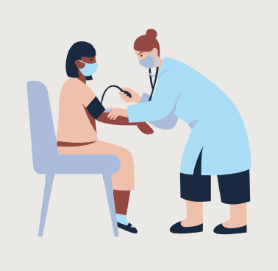
Federally Qualified Health Centers
Federally Qualified Health Centers (FQHCs) provide opportunities to screen patients and offer referrals for serious substance use disorder (SUD) treatment. Little is known about the referral to treatment (RT) process, and no standardized protocol has been accepted across FQHCs. In a study conducted by Palmer, 68% of PCPs listed lack of high-quality treatment options and lack of patient motivation/ability to seek treatment as RT barriers.
In our implementation science process, the clinics requested we collaborate on developing a RT protocol for patients with serious SUD (screened out or the RCT which focuses on risky drug use). Each FQHC had a different approach to RT to pilot in PDSA cycles.
We present here our pilot of a protocol to standardize the RT (referral to treatment) process for patients at high risk for developing severe SUD (WHO ASSIST score ≥ 27).
3
Notes:
Citation: https://ps.psychiatryonline.org/doi/full/10.1176/appi.ps.201800427

Slide 4
Developing SUD Referral to Treatment Protocol
Meetings, weekly – biweekly, with stakeholders from two FQHCs in Los Angeles, CA were organized to develop a Screening, Brief Intervention, and Referral to Treatment protocol, revised from in-person to telehealth during the COVID-19 pandemic.
A unique url link for the pre-visit wellness questionnaire are sent via text to patients with upcoming primary care appointments. Patients are screened using the WHO Alcohol, Smoking and Substance Involvement Screening Test (ASSIST).
Every Friday, the research team emails a list of patients with scores of
≥ 27 to FQHC’s behavioral health team, clinician champion, or patient’s PCP, depending on each clinic’s workflow & preferences.
4

Slide 5
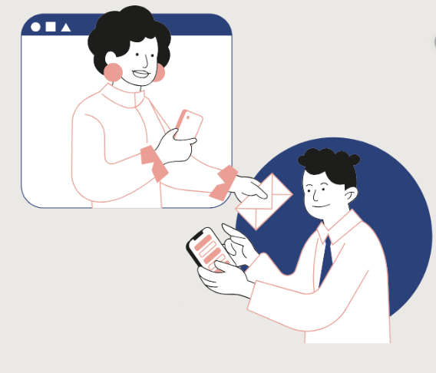
Referral to Treatment Protocol
Behavioral health team at clinic will...
1.Evaluate patients for SUD
2.Refer to treatment
3.Complete a questionnaire to track if patients were assessed and connected to SUD treatment
Early in our PDSA cycles, there were instances where bachelor’s level behavioral health team members were considering ASSIST screening as being diagnostic and referred patients to SUD treatment for further evaluation and appropriate treatment. This is because they did not have the resources to conduct a diagnostic evaluation for SUD.
5

Slide 6
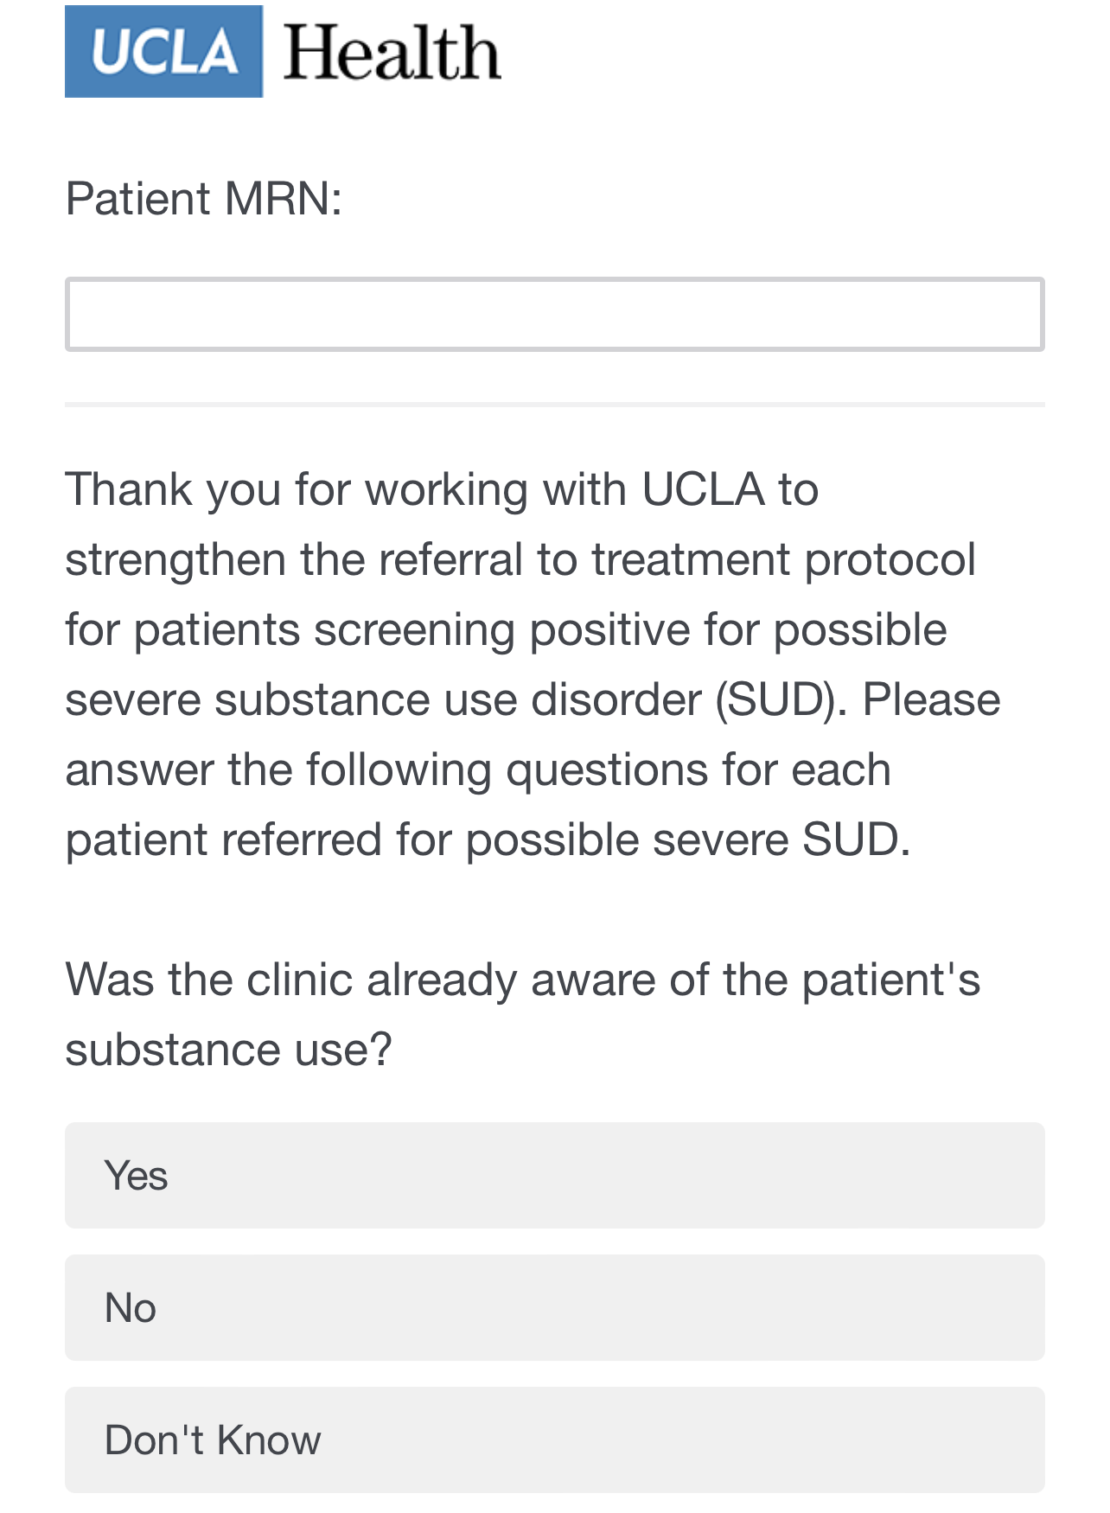
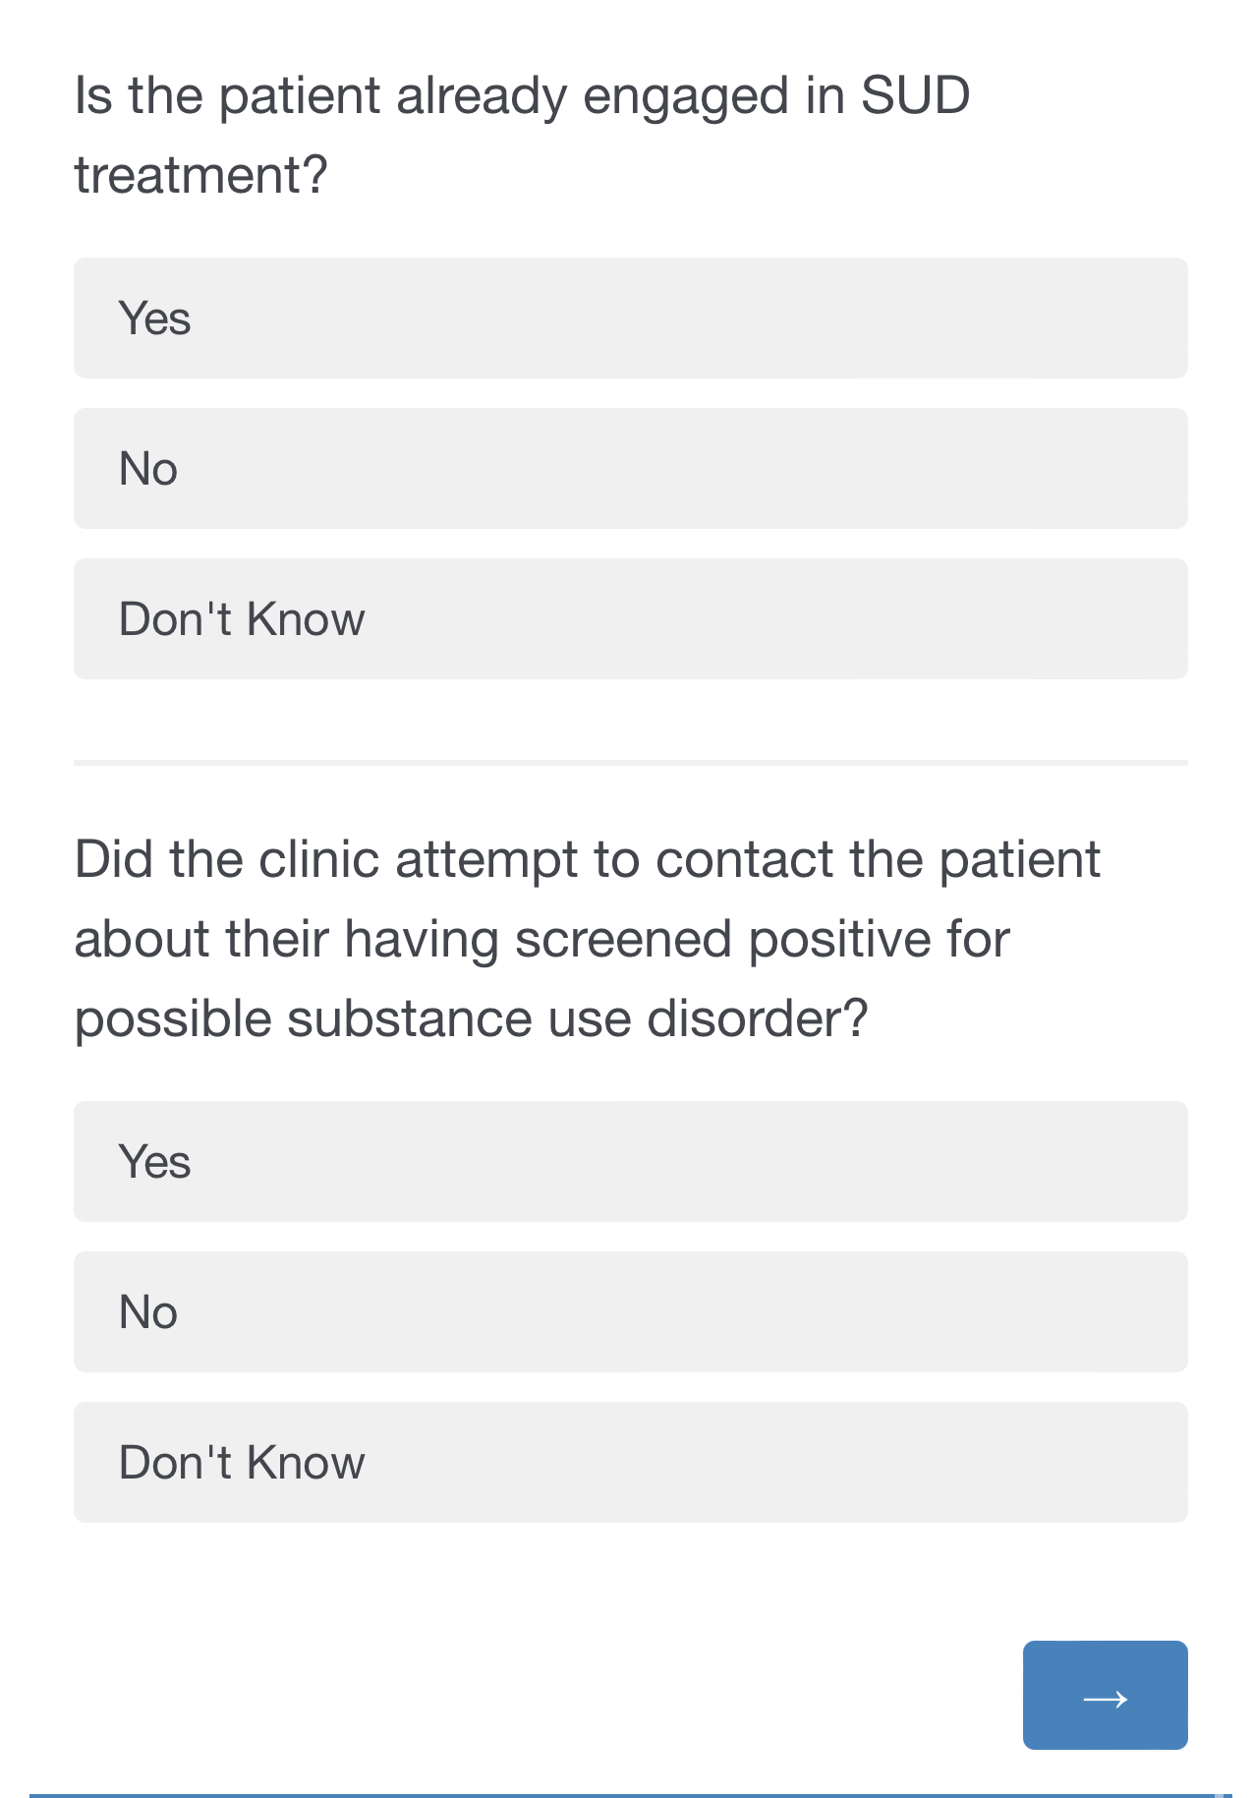
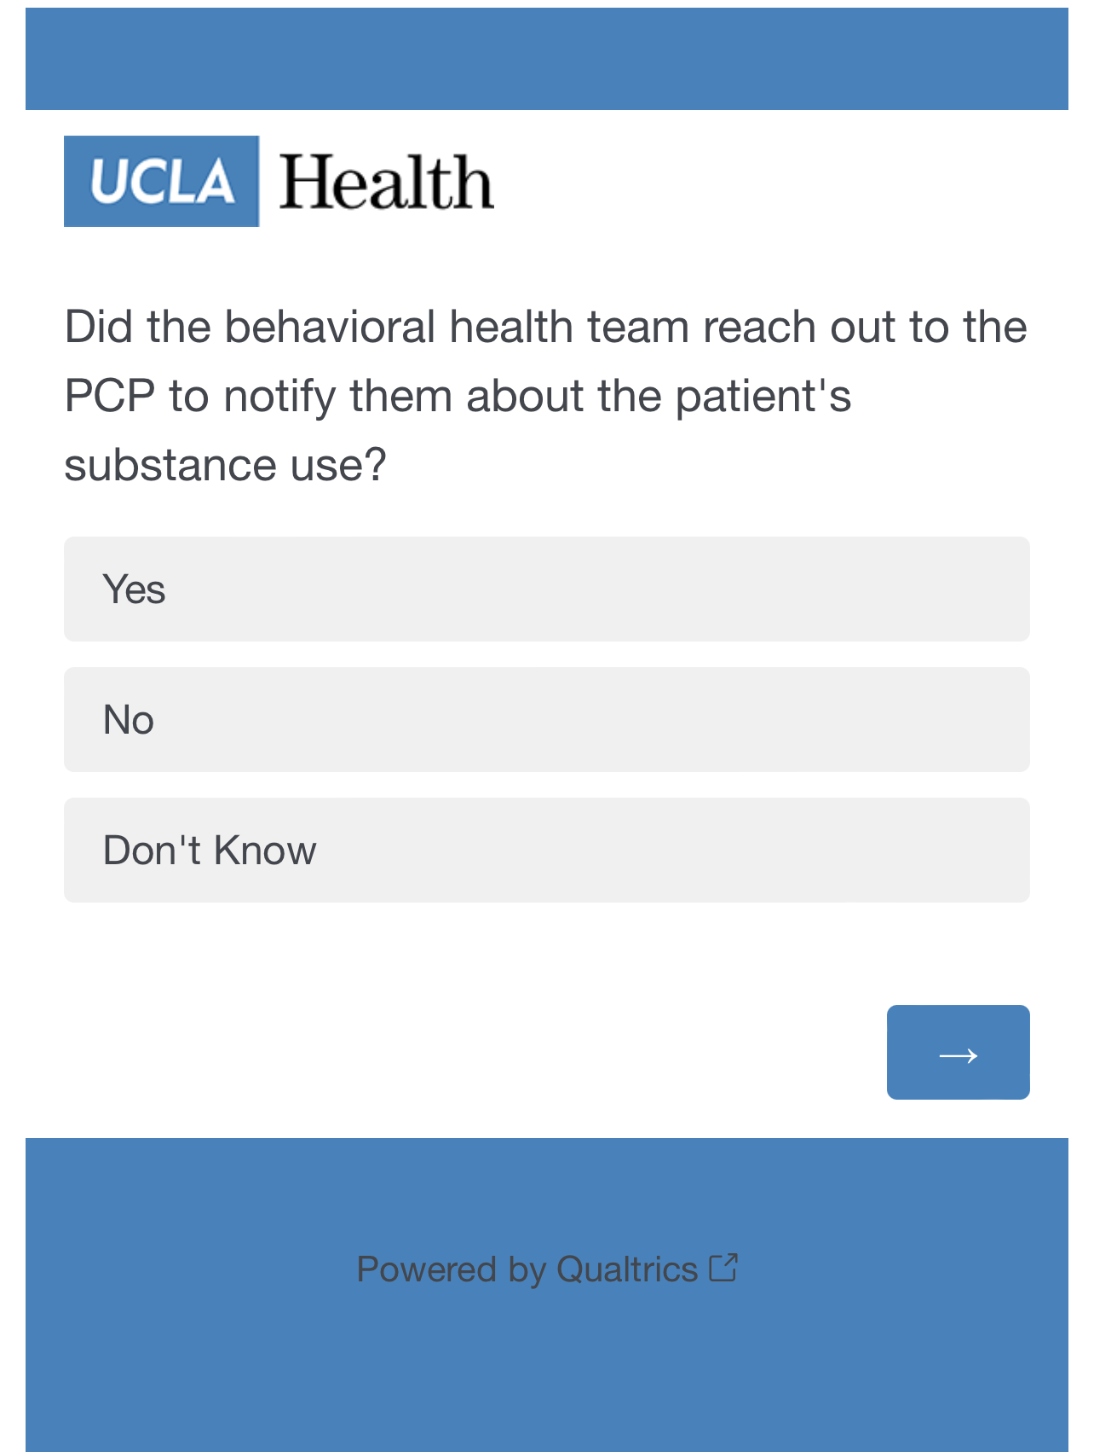
Qualtrics Questionnaire
Who completes the questionnaire? The Behavioral Health Director at one of our partner FQHCs fills out the questionnaire below and sends it back to the QUIT-M study staff, to ensure the patients are receiving referrals to treatment
7
Notes:
Out of 6 patients, thee doctor was aware of half of them (3/6)
Out of 6 patients, only 1 was already engaged in SUD tx
The clinic did attempt to contact 6/6 patients by phone
4/6 were successfully reached
Out of 5 patients, all their PCPs were notified about the patients SU
4/6 patients were referred to substance use services
Out of 4 patients, 2 did begi tx for sud after referral was provided, 1 was unknown and 1 was no
Out of 6 patients, the BH team contacted the pt about possible s3rvivces, once by social worker
Referral types vary: 2/4 patient were given the phinoen number, nd the other 2 had their appt booked for them

Slide 7
2044 participants completed WHO ASSIST screener
Interim Results
April 2022-July 2023
89 identified as having high-risk substance use (ASSIST 27+)
Alcohol
(n=37)
Cannabis
(n=16)
Cocaine
(n=4)
Prescription
Stimulants
(n=1)
Methamphetamine
(n=14)
Sedatives
(n=11)
Prescription Opioids (n=4)
Inhalants
(n=2)
None of the participants had received substance use treatment in the past 3 months before screening (criteria for ASSIST screening for the RCT).​
27.6% (n=21) reported currently using more than one substance with 11.8% (n=9) scoring ≥ 27 on more than one substance.​
75% (n=57) self-reported being a racial/ethnic minority (21.9% Black, 34.2% Latino, 1.4% Asian, 17.8% More than One Race, 21.9% White, and 2.7% did not report)
6
Notes:
2Alcohol 37
Tob 44 ?
Pot 16
Coc 4
Stim 1
Meth 14
Spo 4
Sso 0
Sed 11
Inh 2
Hall 0
Total screened: 2044 data from july 6th
16 White
16 Black
1 asian
---42 total
13 more than one
25 latino
--- 71 total
2 unknown

Slide 8
Referral to Treatment Protocol for Enrolled Patients
.
for All Arms
for QUIT Arms
for QUIT Mobile Arm
1. RAs will monitor for 27+ ASSIST score during the follow up assessment at 3, 6, and 12-months.
2. During the health coaching calls, health coaches (HC) will observe for high substance use (5 out of 7 days for 4 weeks) and report back to health coaching team for further evaluation.
3. HCs will monitor for high substance use (5 out of 7 days for 4 weeks)in the weekly SMS check-in survey and report back to health coaching team for further evaluation.
8

Slide 9
Future Steps
Integration
Next Steps
Qualitative Interviews
These results and pilot referral to treatment protocol can support the integration of health screening to address serious SUD among patients at FQHCs.
Next steps include: continue to screen patients, monitor electronic health records to investigate if patients are connected to SUD services, if treatment was initiated, and barriers.
Qualitative semi-structured interviews with patients, providers, and clinic stakeholders will be conducted to assess barriers and facilitators to implement a standardized referral to treatment protocol.
9

Slide 10
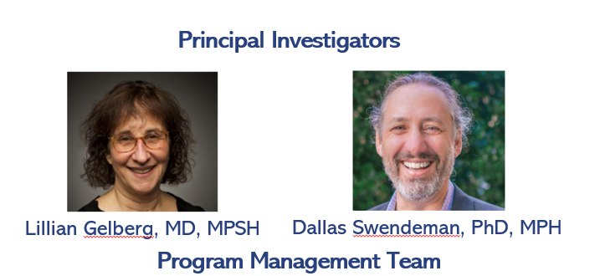
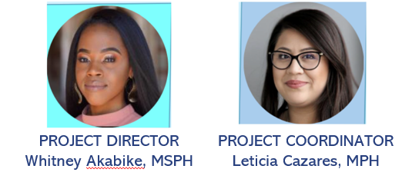
Study Team
If you have any questions or concerns, please contact us at:
livingwellprogram@mednet.ucla.edu
10

