Slide 1
Comparison of Implementing SBIRT in the ED vs the Trauma floor in a Trauma One Hospital
Janice Williams , MSED Director Carolinas Center for Injury Prevention

Slide 2
Abstract
Background: Substance use is under reported when present in incidents resulting in severe injury or fatal outcomes. Currently in the local community, impaired crashes are reported as 14% of total crashes, yet when compared to blood analysis of MVC’s in that community 50-61% are substance positive. SBIRT is a known evidenced based intervention, especially promoted in healthcare settings.
Methods: A trauma one center over the past two decades has implemented SBIRT in different departments and collected barriers, facilitators, staff needs, patient profiles, and outcomes.
Results: Emergency Room implementation is successful when specific staff, timing, patient profile, and treatment access tuning is attained to and is to date the most successful cost savings and satisfaction outcome setting with $700,000 saving in a year compared to traditional case management support. Trauma inpatients are in an early stage of change process and so harm planning and counseling bedside is more applicable since less than 1% qualify or accept a treatment referral and patients as an aggregate present with a lower readiness to change indicator. In both settings, provider and patient interest is high in adoption -if help in translation support and program development is provided.
Conclusion: When SBIRT is adopted with tailored support to patients, setting, and providers, it can be successful in a variety of settings with different but positive outcomes. But more program and patient support data needs to be collected related to implementation science if there is to be widespread adoption with positive outcomes without dedicated site administrative staff.

Slide 3
Background
SBIRT is heavily promoted in hospitals by the Emergency Physicians association and the American College of Surgeons, among others.
Kits and guidance have been developed and structured research of outcomes has been heavily assessed.
Widespread adoption is hindered by limited tailored support and dedicated program development time based on site and patient needs.
Grants allowed a hospital in NC to provide dedicated staff time to implement SBIRT and tackle tailoring for efficacy.
Results will be presented based on implementation in the same hospital’s Emergency Room and Trauma Floor to inform others of potential barriers and facilitators based on differing staff, site, and patient variables.

Slide 4
ED need – at site prior to initial time of work
200 ED patients over a year account for 79% of our repeat visits. A high percentage are substance users.
1500 yearly report to this ED with a diagnosed alcohol use disorder
249 patient visits were coded as opioid specific overdoses
1882 were given naloxone upon arrival as an indication of overdose related visit reason
1627 were admitted for further behavioral assessment.
Summary – there is a high percentage of ED visits already known to have a substance use problem.

Slide 5
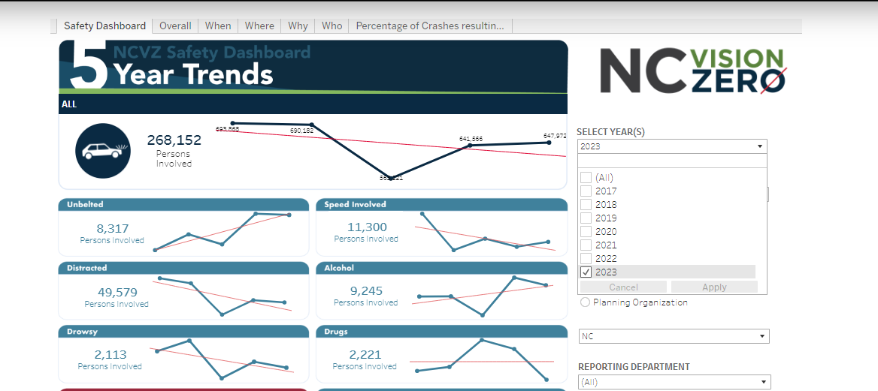
Trauma need at site- “ under reported”
14% of MVC’s say “ impaired related” in DMV reports.
2022 Local Trauma Center data, 49% not tested at all. So small numbers already.

Slide 6








Trauma floor need- under collected- NHTSA funded study 2019-2021- Our site
Same study, 39% of older adult falls- primarily alcohol.

Slide 7
Methods – Implementation
 | Emergency Room | Trauma Floor
Need | Many patients with SUD diagnosis – limited time for those not ( ie SBIRT) High utilizers- so great cost saving potential if done correctly. Case management – discharge planners, don’t know SUD resources. | Positive use- 55% of drivers , 50% occupants MVC, 30% bikers, 55% pedestrians, 39% older adult falls ( NHTSA study) Estimated 23%- 31% violence ( trauma registry data) Need is for safety planning and MI counseling
Patient Profile | High formal addiction diagnosis and problem Nights and weekends presentation Limited resources and support Need to know resources for uninsured ( males) Medicaid managed, homeless. Limited child exposure and only 10% own a vehicle. So identification is very far down the addiction profile to impact other risk areas. | Only road victims seen as of this presentation. Lower addiction diagnosis criterion Higher medical acuity – ie immediate referral not possible. 10% no use, 39% poly use with alcohol lead, 22% alcohol only, 9% poly with benzo’s as the lead. 38% don’t believe they have a problem, 74% said no other professional has ever mentioned use may be an issue. ( SBIRT not done elsewhere, first entry point).
Staff/Service | Thursday – Sunday 2pm- 10pm LCSW or Addiction specialist for assessment and entry language. Assessment- psycho social/Medical Strong staff, can be aggressive/inappropriate patients. | Mon- Friday 8-5 pm Screening if needed ( Audit C or Cage Aid, mostly we know by case presentation ). May not need a screen either, except helps “ profile”. Counseling when agreed is skills ( ie not discharge planning). Multiple visits and call backs when requested, comfort.

Slide 8
Outcomes – Barriers and Facilitators tailored
 | Emergency Room | Trauma Floor
Facilitators | Ready for immediate referral Providers see the impact of addiction, can be more receptive. Teaching hospitals view as niche of experience can provide new residents. | *15-30 minutes counseling is feasible given they are not needing a quick discharge *Could add in other supports since stay longer – AA bedside/Prime for Life. *Trauma ACS – allows for program, not necessarily patient successful program vs checking a box. *Addiction medicine on site for start MAT if needed.
Barriers | Need chronic disease prescriptions- community partner. Transit partner and not use in transit issues. Time on floor issues ( not awake, bed location hall, 4 hour leave – standing ED need) Providers see “ addiction” as the primary ,little time for true SBIRT- undiagnosed. Beds not ready/patient not phone- needed a community partner Needed meetings with treatment sites to overcome why patients not accepted. Keeping staff, hours not “ family” friendly. Cost of specialist – many times hire Peers wrong reason. | Facility charges so no external assessments could be provided because not billable unless discharged first even though “ time” and billing for service overall limited if not MD provided because of this. MAT is tightly controlled -led to kick backs to the ED. Not cognitively ready, and no treatment site will take if still medical healing. Many more staff needed because need to find patients, review records, wait for other medical care provided to patients, and provide long counseling session so 4-6 a day seen averaged. Referral options are limited for those not qualifying for addiction under DSM criterion and even lower patient willingness to pay for those type of efforts.
Both have initial resistance from
Case Management and BH services

Slide 9
Outcomes
 | Emergency Room
Qualitative | SBIRT- counselors handle referral directly can identify patient referral location better. 100% of providers responded to keep the program out of all others offered in ED to patients.
Quantiative | *84% participated needed an hour or longer session to counsel toward treatment and get items needed for correct referral. *SENT DIRECT TO SUD treatment- 96% of patients – key to success not “ referral alone”. * $704,000 saved in repeat SUD visits for these patients for 12 months pre and post compared to control patients who just received traditional case management services. ( not other medical visits)

Slide 10
Outcomes
 | Trauma Floor
Qualitative | * SBIRT counselors only counsel referrals are handled by Addiction medicine or Case Management. *Most harm planning agreement as a group was to reduce days of use ( 36% use three or more days a week). *88% of reason for use can be categorized under - loneliness, negative social connections at home or friends, and boredom. * Harm planning - Use substance at home to not be on road. ( not designated driver or uber) most accepted message.
Quantitative | *38% agreed to 15 minutes or less MI talks but no more. *Nursing pre screens with Audit C only match actual urinalysis or patient profile in chart via case presentation in 12% of cases. *Savings of repeat visits and DMV crash reports for second crashes to be analyzed *366 Positive patients identified by one FTE for 9 months. ( road only) 233 Positive for Substance in system or screening positive ( Audit C, Audit PC, Cage Aid) 21 declined counseling, 51 qualified for referral to treatment only one accepted. While “counseling” can be treatment, at this stage, very few wanted to pay for the formal assessment fees or outpatient counseling as a treatment. So floor counseling is critical

Slide 11
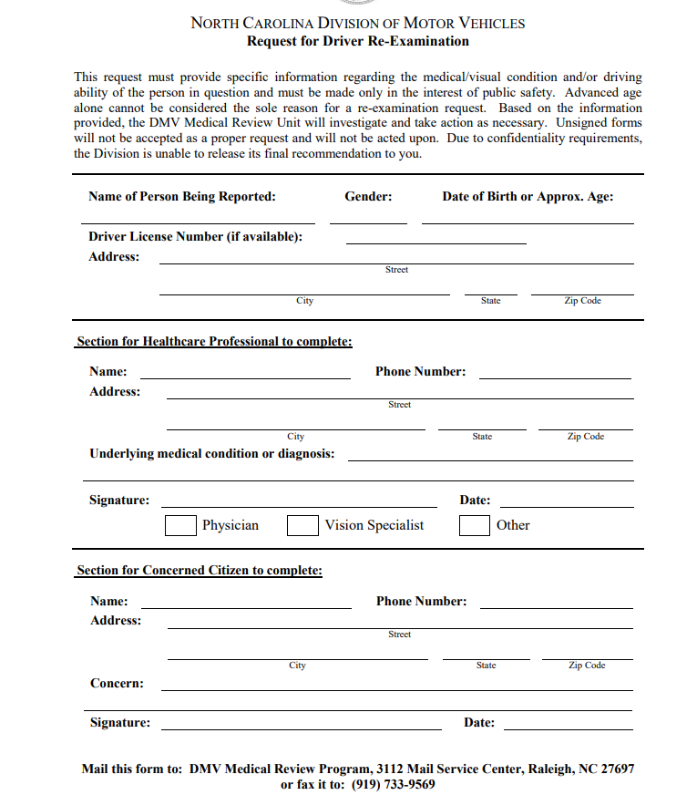
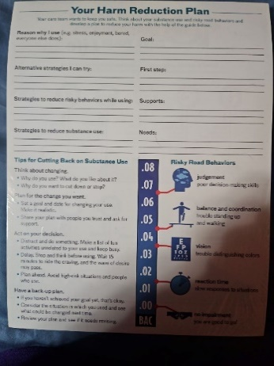
Other Healthcare/Other findings
Pastoral Care
Limitation for them is that most providers only trigger a consult if “ religion” mentioned or death.
“Niche” is denial/shame
Case Management /Parrish Nurses/Community/IP
Case management- discharge planning services mostly/not familiar with BH services in community. Service the whole hospital. Can use DMV forms for starting other assessment models in patients life.
Parrish Nurses/Home Health/Community IP- Great expansion options, comfort/knowledge/skills a barrier.

Slide 12
Conclusions
SBIRT is an under utilized tool and could be more widely used if local tailoring occurred. Patient profiles need to be accounted for, staffing and training needs to occur, support structures need to be allotted for in time and management and outcomes need to be realistic depending on the setting.
ED setting is most useful for addiction treatment access and results in cost savings when sent direct to treatment and staff are qualified with nights and weekend work.
Trauma setting is most useful for MI counseling toward harm reduction prior to the addiction profile entry.
Program staff can be useful in working on barriers and facilitators to make the program most useful.
Other partners and settings should be considered for SBIRT given the high rate of substance presence in negative outcomes for people.
* Note these findings are based on the work in our setting by an external entity to the clinical care with no bias. The work is meant to inform other clinical settings of the need for tailoring and some issues encountered. The team believes the patient profile is universal, but acknowledges, the other information may be slightly different by healthcare setting given differences in site and program set up. *
Janice.williams@atriumhealth.org 704-208-6428

