Slide 1
Providing Culturally Safe Interventions to Prevent Alcohol-Exposed Pregnancies
Megan Waddell, Corrie Whitmore, Faith Ozer Green, Janice Vendetti, Bonnie McRee, Karen Steinberg, Diane King
Notes:
Hello. My name is Megan Waddell, I am a PhD student in clinical community psychology and these are my colleagues Faith Green and Corrie Whitmore. Today we will be discussing Providing Culturally Safe Interventions to Prevent Substance-Exposed Pregnancies.

Slide 2
Contributors & Organizations
Notes:
The study we are discussing today is a collaboration between the Centers for Behavioral Health Research and Services at the University Alaska Anchorage and the University of Connecticut. The University of Connecticut team partnered with the Planned Parenthood of Southern New England, which has locations in Rhode Island and Connecticut. The University of Alaska partnered with Planned Parenthood of the Great Northwest, Hawai’i, Alaska, Indiana and Kentucky which provides reproductive healthcare services and education through its 35 health centers located in Alaska, Hawai’I, Idaho, Indiana, Kentucky and western Washington. Both university teams operated under a CDC grant aimed at implementing alcohol screening and brief intervention with the intention of reducing fetal alcohol spectrum disorders.

Slide 3
What is cultural safety?
Cultural safety requires healthcare professionals . . . to acknowledge and address their own biases, attitudes, assumptions, stereotypes, prejudices, structures and characteristics that may affect the quality of care provided . . . and hold themselves accountable for providing culturally safe care, as defined by the patient and their communities, and as measured through progress towards achieving health equity.
It is not lack of awareness about ‘the culture of other groups’ that is driving health care inequities - inequities are primarily due to unequal power relationships, unfair distribution of the social determinants of health, marginalisation, biases, unexamined privilege, and institutional racism.
Curtis et. al. (2019). International Journal for Equity in Health.
Notes:
Cultural competence acknowledges and respects the culture of the person or organization being served - cultural safety goes farther than that

Slide 4
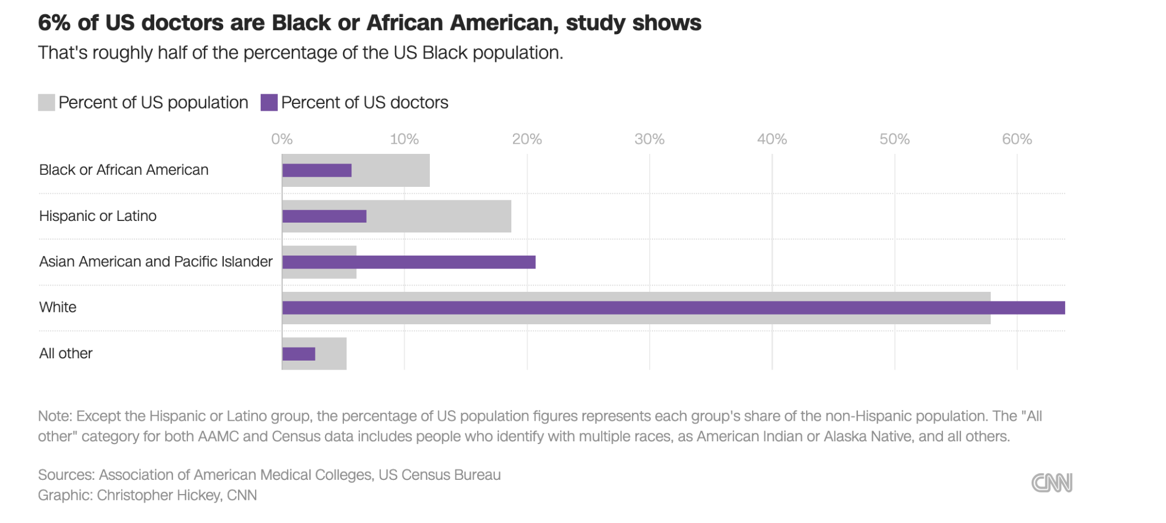
Gaps in Health Care
Demographic differences often exist between providers and the populations they serve
Can lead to assumptions, misunderstandings, and a lack of comprehensive care
Racial, religious, socioeconomic, gender and sexual identity
Notes:
‘The therapeutic relationship between a health provider and a patient is especially vulnerable to the influence of intentional or unintentional bias leading to the “paradox of well-intentioned physicians providing inequitable care. Equitable care is further compromised by poor communication, a lack of partnership via participatory or shared decision-making, a lack of respect, familiarity
or affiliation and an overall lack of trust.” CURTIS ET AL 2019
Approximately 1 in every 13 pregnant women who reporting consuming alcohol during their pregnancy had a child with an FASD
Misconceptions about contraception use are pervasive, and provider biases may result in missed opportunities for screening and counseling
There is an extensive history of bias surrounding contraceptive and gynecological care, especially for POC
This can contribute to recommendations that are not culturally informed or are ineffective for the targeted individuals
FASDs are common but highly preventable - how common drinking is across the population
Stats and graphics about FASDs
Misconceptions about contraception use are pervasive - missed opportunities on behalf of providers
Provider bias may result in some groups being less likely to receive interventions than others
A complicated history of provider bias exists around contraceptives and gynecological care, especially for POC
Results in recommendations of contraceptive that are not culturally informed or are ineffective for the individuals being counseled
Demographics of people working in women’s health vs who is served in these clinics
Are there racial and ethnic differences in AEPs in the data?
?Differences in likelihood of diagnoses? Differences in screening? Differences in use?
FRICTION in the differences
Then introduce provider education and cultural competency
Current best-practices have led contraceptive providers to increasingly use a patient-centered approach to counseling individuals about contraceptives (Welti et al., 2022). Patient-centered care considers the individual’s lifestyle, health and sexual behavior to determine contraception recommendations.
This approach fails to consider the systemic and historical biases, cultural beliefs about pregnancy, and patient concerns about contraception safety, and may diminish patient trust and receptivity to recommendations, exacerbating health disparities.
In this study, we explored the consistency of delivering universal alcohol screening and brief intervention (SBI) services to patients seeking care at two nationwide Planned Parenthood affiliates and provide recommendations on how culturally informed, patient-centered counseling is integral to equitable reproductive health care counseling and care.
Best practices for contraception care are patient centered - culturally competent
Contraceptive counseling is one method of FASD prevention
Paired with substance use screening, there is a lot of opportunity for stigma/bias to enter the discussion
“Contraceptive counseling and alcohol screening and interventions often fail to consider risk factors and cultural differences in attitudes towards substance use, pregnancy, and contraceptive use. This can result in ineffective and biased counseling and interventions, mistrust toward contraceptive providers, and misconceptions about contraceptives.”
Global Prevalence of Fetal Alcohol Spectrum Disorder Among Children and Youth - PMC (nih.gov)

Slide 5
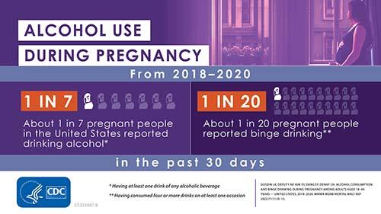
Alcohol-Exposed Pregnancies
Alcohol use during pregnancy has increased over the last two decades
Misconceptions about substance use and contraception use are pervasive
Provider biases may result in
missed opportunities for
screening and counseling
Likelihood of an alcohol-exposed
pregnancy as a measure
Less effective contraception
method
Any alcohol consumption

Slide 6
Study Design & Sample
White Non-Hispanic 44.4% Hispanic 26.4%
Black 20.1%
Asian/Pacific Islander 2.6% Alaskan Native/American Indian 0.4%
Unknown 6.1%
PPSNE
N = 12,471
Patients assigned female at birth, aged 18-49
who completed wellness visits between 06/01/2020 - 10/31/2022
PPGNHAIK
N = 17,188
White Non-Hispanic 68.8%
Black 7.7%
Multiracial/Other 8.3%
Asian/Pacific Islander 5.4%
Alaskan Native/American Indian 1.5%
Unknown 8.4%
Electronic health record data were analyzed to identify differences between racial and ethnic groups for alcohol screening rates, method of contraception, and brief intervention rates.
Notes:
Electronic health record data from 29,659 total encounters between the two affiliate groups was analyzed. Data was extracted for all patients who were assigned female at birth, aged 19-49 who completed preventative wellness visits between June 1 2020 and October 31 2022. A total of 12,471 encounters that occurred through the Planned Parenthood of Southern New England were analyzed. This population reported to by 44.4% white non-hispanic, 26.4% hispanic, 20.1% black, 2.6% Asian Pacific Islander, .4% Alaskan Native/American Indian and 6.1% unknown. These were compared to the sample of 17,188 individuals who were seen by the Planned Parenthood of Greater Northwest, Hawai’i, Alaska, Indiana and Kentucky. Of this population, 68.8% of participants reported to be white non hispanic, 7.7% were black, 8.3% were multiracial or other, 5.4% were Asian or Pacific Islander, 1.5% Alaskan Native/American Indian and 8.4% unknown. The differences in race and ethnicity are largely attributed to the different geographic locations of the affiliates.

Slide 7
Measures & Methods
Measures:
Contraceptive Method
(More / Less Effective)
Alcohol risk level
US Alcohol Use Disorder Identification Test (USAUDIT) brief and full-screen
Analyses
Two-sided t tests with Bonferroni adjustment alpha =.003 to compare contraceptive effectiveness and alcohol SBI implementation across racial and ethnic groups
Notes:
Background on population- where it is and demographics
Chart showing contraceptive tiers (not list)
Table with findings
Context as where- clinics/PWVs
Universal alcohol SBI implementation included screening for alcohol use using the US AUDIT and providing a brief intervention and referral to treatment, when needed.
Two-sided t tests with Bonferroni adjustment alpha =.003 to compare contraceptive effectiveness and alcohol SBI implementation across racial and ethnic groups and identify any statistically-significant differences in the care these groups of patients received.
During preventative wellness visits, patients should also receive contraceptive counseling, with a birth control method recorded by the provider.

Slide 8
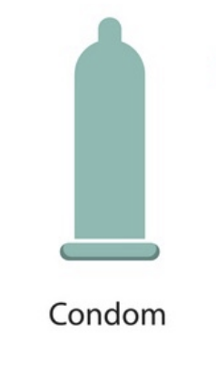
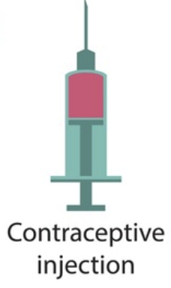
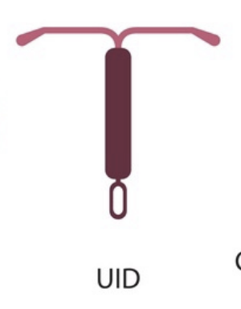
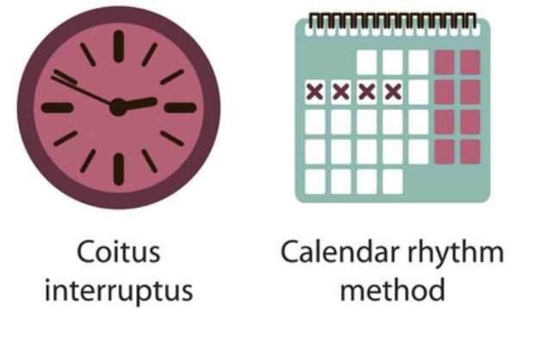
Classifying Contraceptive Methods
More Effective
Contraceptive methods that are 88% or more effective at preventing pregnancy.
(for example: IUDs, implants, or injections).
Contraceptive methods that are less than 88% effective at preventing pregnancy
(for example: condoms, spermicide, or withdrawal)
Less Effective
IUD

Slide 9
Findings - Screening
Screening Rates-
PPNSE: Black and Hispanic patients were less likely to be screened than White patients.
PPGNHAIK: Asian/Pacific Islander and Multi-racial/Other patients were less likely to be screened than White or Black patients.
Alcohol Risk Level (any use / risky use):
No differences by Race/Ethnicity at either affiliate
Brief Intervention Rate:
No differences by Race/Ethnicity at either affiliate
 | Percent Not Screened for Alcohol Use
 | PPSNE (%) | PPGNHAIK (%)
Full sample | 14.6% | 9.9%
Asian/Pacific Islander | 17.4% | 8.7%
Black | 16.3% | 11.3%
Hispanic Ethnicity¹ | 15.8%
Alaska Native/ American Indian | 15.7% | 9.9%
White | 12.7% | 10.4%
Multi-racial/Other Race |  | 8.9%
Unknown | 16.4% | 6.7%
Notes:
Remind audience that this table shows percent NOT SCREENED, so a smaller number indicates better screening rates.
At PPSNE (n=12,471), 16.3% of Black patients and 15.8% of Hispanic patients were not screened for alcohol use, compared to 12.7% of White patients. These differences were statistically
significant (p<.001).²Black and Hispanic individuals are less likely to be screened than White individuals at PPSNE
³Asian/Pacific Islander and Multi-Racial/Other Race individuals are less likely to be screened than White and Black individuals. Those with Unknown race are less likely to be screened than those in all other categories at PPGNHAIK

Slide 10
PPGNHAIK Sample
Characteristic | Full sample (n=13,258) | Asian/Pacific Islander (n=714) | Black (n=1,020) | Multi-Racial or Other (n=1,098) | AK Native/ Am. Indian (n=198) | Unknown/ Prefer Not to Answer (n=1,108) | White (n=9,120)
More effective contraceptive method | 93.6% | 95.4% | 91.2% | 91.4% | 93.9% | 92.0% | 94.1%
Less effective contraceptive method | 6.4% | 4.6% | 8.8% | 8.6% | 6.1% | 8.0% | 5.9%
Any Alcohol Use and Less Effective BCM (at risk for AEP) | 5.0% | 3.6% | 6.7% | 6.6% | 5.6% | 6.6% | 4.5%
Characteristic | Full sample (n=10,303) | Asian/Pacific Islander (n=257) | Black (n=2,008) | Hispanic (n=2,679) | AK Native/Am. Indian (n=41) | Unknown (n=612) | White (n=4,706)
More effective contraceptive method | 69.0% | 69.6% | 59.1% | 68.8% | 65.9% | 65.8% | 73.8%
Less effective contraceptive method | 31.0% | 30.4% | 40.9% | 31.2% | 34.1% | 34.2% | 26.2%
Any Alcohol Use and Less Effective BCM (at risk for AEP) | 24.8% | 23.3% | 33.4% | 22.7% | 31.7% | 27.9% | 21.9%
PPSNE Sample
*p<.003
Notes:
As you can see from this table, at PPGNHAIK, Black and Multi-racial/Other Race patients were significantly more likely to report using a less effective method of pregnancy prevention than Asian/Pacific Islander and White patients. Black patients were significantly more likely to use a less effective method of pregnancy prevention compared to White patients.
At PPGNHAIK, 5% of the screened population with a birth control method recorded reported using some alcohol and a less effective method of birth control, indicating a risk of Alcohol Exposed Pregnancy (AEP). The risk of experiencing an AEP differed among groups, with Black and Multi-racial/Other patients more likely to be at risk for AEP than Asian/Pacific Islander and White patients (p < .001 and p = .003, respectively).
At PPSNE, significantly more Black patients used Less Effective contraception, compared to Asian/Pacific Islander, Hispanic, or White or patients with an Unknown race/ethnicity. Hispanic patients and patients with an Unknown race/ethnicity were significantly more likely to use Less Effective method than White patients.
When you look at contraceptive method and alcohol use on this table, at PPSNE Black patients were at the highest risk for an AEP with a greater likelihood of reporting alcohol use and using less effective contraception, compared to Asian/Pacific Islander, Hispanic, or White patients. Those with an Unknown race/ethnicity also had a statistically significant higher risk of experiencing an AEP than White patients.

Slide 11
Discussion & Conclusions
Findings indicate differences by racial and ethnic groups for
Rates of alcohol screening
Use of effective contraception.
Risk for an alcohol-exposed pregnancy
Results may be indicative of:
Provider biases
Patient misconceptions about contraceptives
Cultural attitudes toward alcohol use and pregnancy
Provider biases and lack of cultural safety
Inconsistent substance use screening
Ineffective contraceptive counseling and increased risk of AEP
Notes:
Racial differences in alcohol screening frequency may be indicative of provider biases
Efficacy of contraceptive method varied by racial and ethnic group
Provider bias, misconceptions about more effective forms of contraceptives
Racial differences in alcohol screening frequency and racial differences in contraception use
may be indicative of provider biases or discomfort, cultural norms and preferences
Link findings on use of less effective contraception methods and high risk of AEP to potential provider bias and gaps in contraceptive counseling
Despite universal delivery of SBI, intervention effectiveness requires identifying whether patients with higher risk factors are being offered information and advice in an environment that fosters trust and respects their choices for contraception and alcohol use.
Consideration of racial, cultural, socioeconomic, social and religious preferences - requires effective two-way communication with the patient about their preferences
Cultural safety can be improved by addressing individual, professional and systemic biases and power differentials that undermine the effectiveness of reproductive health counseling.
Cultural safety vs cultural competency vs provider bias training - definitions needed and research to be implemented in practice
Assumptions
Are there racial and ethnic differences in AEPs in the data?
?Differences in likelihood of diagnoses? Differences in screening? Differences in use?
FRICTION in the differences
Then introduce provider education and cultural competency
Insert table showing differences in screening frequency
Patients who are Black and Multi-Racial were at a greater risk for an AEP than Asian/Pacific Islander and White patients

Slide 12
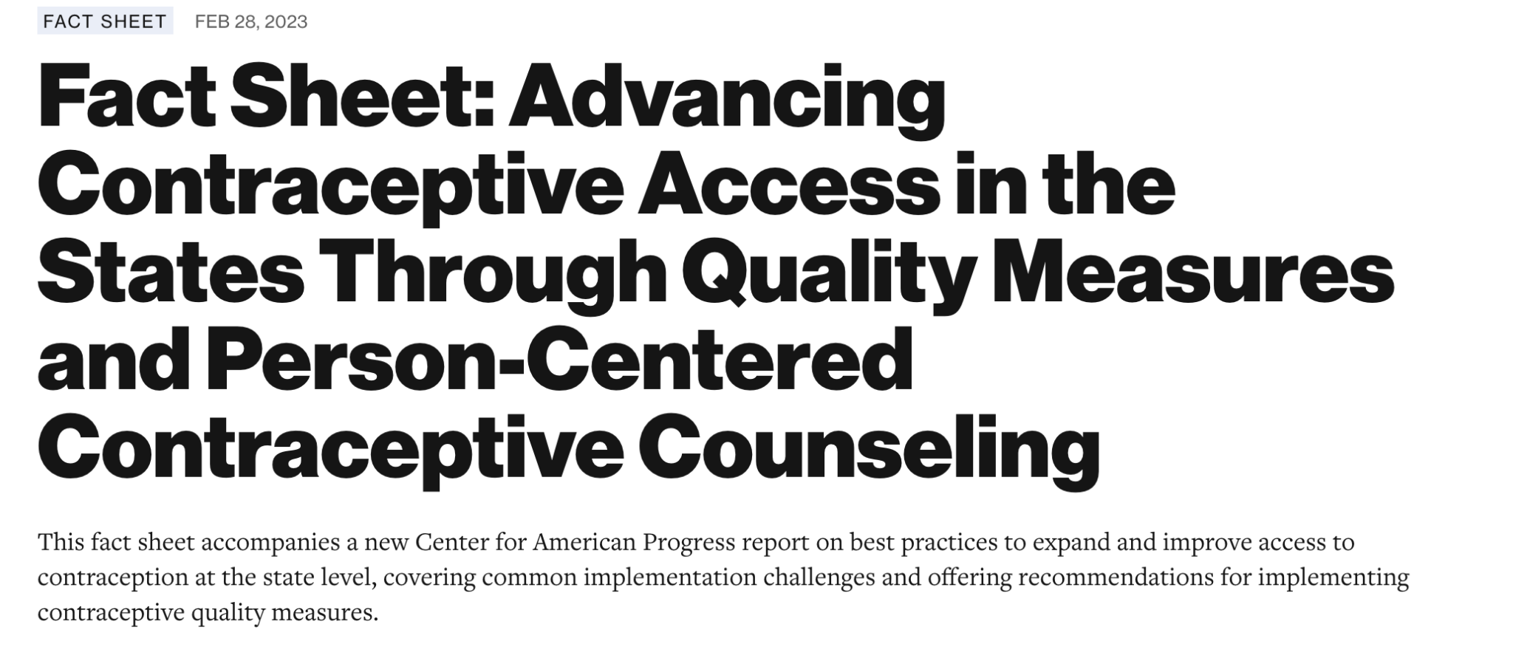
Implications for Practice
Educating providers about the impact of biases on care quality
Addressing care disparities in screening can help address differences in quality of care
Implementing standardized screening tools universally may help facilitate conversations about substance use and contraceptives
Understanding how personal needs and experiences influence patients’ understanding of pregnancy and substance use can help facilitate culturally safe patient interactions
Notes:
Discrepancies in screening and counseling practices highlight the importance of educating providers about the impact biases may have on care quality
Awareness may highlight areas for increased cultural consideration in practice
Cultural safety requires provider awareness about how their own biases may influence their interactions with their patients
Standardized screening tools may help providers effectively facilitate conversations about substance use and contraceptives with all patients
Effective and culturally safe patient interactions may be provided by gaining an understanding of how personal needs and experiences influence patients’ understanding of pregnancy and substance use
Assumptions about contraception use and reliability can be challenging to practice
Education about effectively counseling patients from diverse backgrounds can help address differences in quality of care
Unsure of cause of gap - discussing gap in healthcare setting/with providers may be helpful
Consistency in provider practices with screening and counseling is important
Contraceptive and substance use counseling are an important part of preventative care, as they provide patients with information that can prevent AEPs
Cultural safety requires provider awareness about how their own biases may influence their interactions with their patients
Standardized screening tools may help providers effectively facilitate conversations about substance use and contraceptives with all patients
Effective and culturally safe patient interactions may be provided by gaining an understanding of how personal needs and experiences influence patients’ understanding of pregnancy and substance use
Assumptions about contraception use and reliability can be challenging to practice
We know differences exist between providers and who they care for - there are racial and ethnic differences in outcomes that are linked to patterns in substance use and patterns in contraception use
Those things can be affected by patient provider relationships - therefore educating providers can reduce those differences, potentially decreasing AEPs
Substantiate those linkages

Slide 13
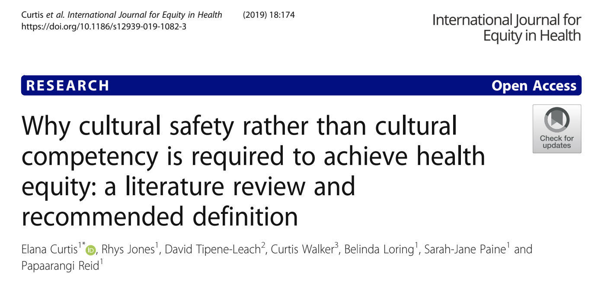
Directions for Further Research
Examination of the impact of provider biases on information, interactions, and care provided to patients
Self-reporting measures across states of varying drug legalization
Increased understanding of how
health education materials can
be utilized to communicate with
diverse communities
Methods to train providers to offer
evidence-based, culturally safe care
Notes:
Gaps continue to exist in reproductive healthcare, and additional research is needed to further explain the causes of discrepancies in care
Provider biases may impact the information, interactions, and care clinicians provide to their clients - what does this look in practice? Research here in when there are discrepancies between provider population makeup and patient population BEYOND race/ethnicity/age
More research needs to be conducted on factors that influence patients’ contraceptive decision-making
What makes care culturally competent? How can this be trained and implemented?
Improving measures of substance use during pregnancy and in general with concerns about self reporting
More research needs to be done regarding self-reporting measures in legal vs illegal states as well as polysubstance use measures
Increased research on the effects of cannabis use / polysubstance use during pregnancy
How can we train providers to offer evidence-based, culturally competent care
What is the impact of provider bias?
Do health education materials need to be changed or expanded on for use in diverse communities

Slide 14
Thank you
This work was supported by the US Department of Health and Human Services (DHHS), Centers for Disease Control and Prevention (CDC) NU84DD000005.
The content and findings in this presentation are those of the authors and do not reflect the official views of the CDC, DHHS, Planned Parenthood of the Great Northwest, Hawai’i, Alaska, Indiana, Kentucky, Planned Parenthood of Southern New England, Inc., Planned Parenthood Federation of America, Inc., the University of Connecticut or the University of Alaska at Anchorage.
Notes:
Just read this

