Slide 1

Substance use patterns across cannabis-legalization-status states served by a multi-state reproductive healthcare organization
Faith Ozer Green, Corrie Whitmore, Megan Waddell, Diane King
University of Alaska Anchorage
Division of Population Health Sciences,
Center for Behavioral Health Research and Services

Slide 2


About the Authors & Organization
Notes:
The Center for Behavioral Health and Research Services (CBHRS) is a University of Alaska Anchorage-based organization that promotes healthy behaviors at the individual and community level through scientific research.
Planned Parenthood of the Great Northwest Hawai’i, Alaska, Indiana, Kentucky (PPGNHAIK), provides reproductive healthcare services and education through its 35 health centers located in Alaska, Hawai’I, Idaho, Indiana, Kentucky and western Washington.
Our academic-health system Alcohol Screening and Brief Intervention (ASBI) implementation team collaboratively planned, designed, integrated, and evaluated system-level practice changes across 35 health clinics in a regional six-state affiliate of Planned Parenthood. We implemented Alcohol Screening, Brief Intervention, and Referral to Treatment (aSBIRT) processes in a large reproductive health system to emphasize substance-exposed pregnancy prevention.

Slide 3
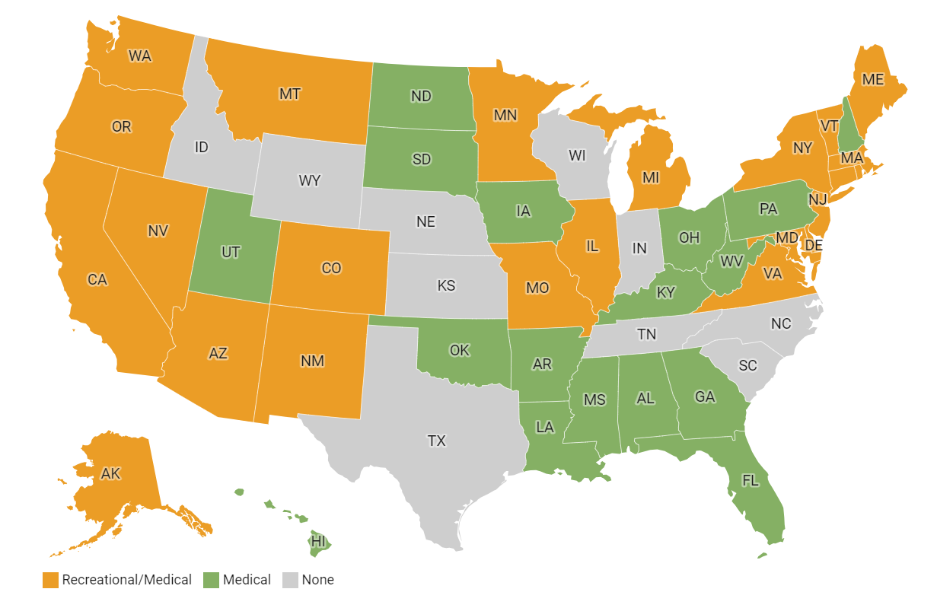
Background
Recreational cannabis is currently legal in 23 states
Legal recreational use states
  Alaska, Washington
No recreational use states
  Idaho, Indiana, Kentucky
Examining patterns of substance use across categories
Notes:
Recreational cannabis is currently legal in 23 states as of 2023
Policies surrounding cannabis are rapidly changing in favor of cannabis
Recreational cannabis use was first legalized in Washington in 2012 and medical cannabis is legal 40 states - for this study we focus on two state categories: legal recreational use states and no recreational use states (LRU and NRU)
There is little information about how legalization impacts cannabis use patterns and how LRU states differ from NRU states
There is uncertainty surrounding cannabis legalization on use patterns, relationships with other substance use, and limitations to investigating substance use
This study looks to examine differences in use patterns between LRU and NRU states
STATS/Graphic: https://www.samhsa.gov/data/sites/default/files/report_2121/ShortReport-2121.html

Slide 4
Study Design & Sample
Sample:
  Adults assigned-female-at-birth, aged 18-44,
  Who completed wellness visits between October 1, 2022 and February 28, 2023
  At clinics in Washington, Alaska, Idaho, Indiana, Kentucky (N=5555)
Analyses compared substance use and contraception rates among similar patient groups across Legal Recreational Use (LRU) and No Recreational Use (NRU) states using electronic health records.
Notes:
Data were extracted from electronic health records for adults assigned-female-at-birth, aged 18-44, who completed wellness visits between October 1, 2022 and February 28, 2023.
All individuals included in this data set were seen at clinics in Washington, Alaska, Idaho, Indiana, Kentucky (N=5555).
Individuals who were not assigned- female- at- birth were excluded because they make up the minority of encounters at these health centers. Additionally, the gender data for individuals who identified as transgender women or non-binary was not robust or reliable enough to draw conclusions for this demographic.
Due to these limitations or this study is specifically examining social and behavioral patterns for the population identified as female.
Analyses - The analyses compared women’s self-reported drug and alcohol use and contraceptive strategies by women in states where recreational cannabis use is legal (Alaska and Washington) to women in states where recreational cannabis use is illegal (Idaho, Indiana, and Kentucky). Self reporting challenges but assumption made that these differences were real differences and not differences in reporting

Slide 5
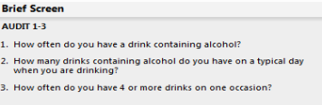
Measures
Classifying Contraceptives
Classifying Contraceptives
More Effective
Contraceptive methods that 88% or more effective at preventing pregnancy.
(for example: IUDs, implants, or injections).
Contraceptive methods that are less than 88% effective at preventing pregnancy
(for example: condoms, spermicide, or withdrawal)
Less Effective
Drug Abuse Screening Test (DAST-10)
Alcohol Use Disorder Identification Test (USAUDIT) - Brief & Full Screening
Notes:
Contraception: [FILL IN DATA ON TIERS HERE]
Alcohol Use: The U.S. Alcohol Use Disorder Identification Test (U.S. AUDIT) is a ten item questionnaire that is used to screen for problematic alcohol use. It and is administered to clients/patients first as a brief screen (three questions) and then - when indicated by answers on the brief screen - potentially escalated to a full screening (ten questions) based on participant drinking behaviors. Individuals with a positive brief screen self-report potentially unhealthy use - such as binge drinking. - and a The full screen, used when the brief screen is positive, gathers data about is used to identify specific unhealthy behaviors to inform a brief intervention and possible referral to treatment.
Drug use: Similarly, the Drug Abuse Screening Test (DAST-10) is also administered first as one question and then - when patients for users who indicated any drug use - escalated to a full assessment.
The screenings are administered to all patients attending preventative wellness appointments and are used during the visit to evaluate client alcohol/substance use patterns and educate patients on safe use, with the goal of decreasing patients’ risk for substance-exposed pregnancies. Both the US AUDIT and DAST-10 screeners are primarily used during the mobile check-in process, with automated prompts from brief to full assessment when an individual has a positive score. These screeners are also conducted by staff, when issues occur with the mobile process or otherwise as needed. The screenings are administered to all patients attending preventative wellness appointments and are used during the visit to evaluate client alcohol/substance use patterns and educate patients on safe use, with the goal of decreasing patients’ risk for substance-exposed pregnancies.

Slide 6
Demographic Differences
N = 5555
LRU N = 4037
NRU N = 1516
Mean age = 31
Mean age = 30.4
White Non-Hispanic 73.2% Multiracial Hispanic 3.3%
Multiracial Non-Hispanic 10.2% White Hispanic 2.3%
Black 8.9% AI/AN 2.1%
White Non-Hispanic 68.6% Multiracial Hispanic 1.5%
Multiracial Non-Hispanic 7.1% White Hispanic 2.3%
Black 20.2% AI/AN 2.0%
*Significant differences between the LRU and NRU states on age (LRU SD 8.0 years) (NRU SD 8.4 years); significant at p <0.01
**Significant differences in racial and ethnic makeup, with NRU states having a larger sample who identified as Black (20.2% compared to 8.9% in LRU states, significant at p <0.001).
***LRU states had 453 individuals of unknown or unreported race and NRU states had 56 individuals of unknown or unreported race
Notes:
Division of states - LRU vs NRU
Pie chart of sample size
Bar charts for categories in I/II bullet points
Sankey diagram or state category to use disclosure to binary use

Slide 7
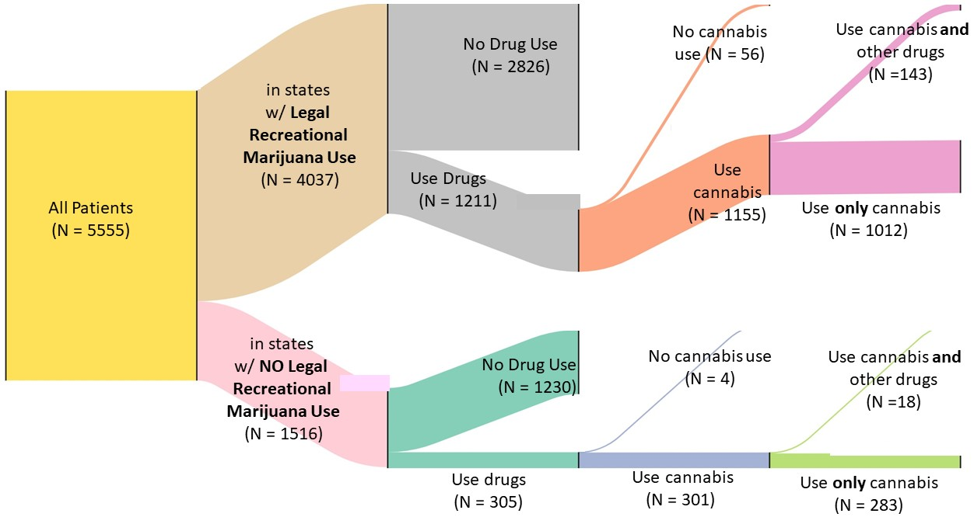
Use Patterns in LRU vs NRU States
*
*
Made with SankeyDiagram.net
Notes:
LRU states 30.0% of individuals who completed screening had positive DAST-10 scores, indicating the use of non-prescribed/illegal drugs, as opposed to 18.8% of individuals who completed the screening in NRU states (p <.001).
Among those who reported using drugs (i.e. positive score on DAST-10), there was a significant difference between rates of cannabis use in LRU and NRU states: 95.4% of those with positive DAST-10 scores in LRU states indicated they used any cannabis; 98.8% of their counterparts in NRU states indicated they used any cannabis (p < .05).
Within this same population of individuals with positive DAS10 scores who indicated which substances they used, patients in NRU states were significantly more likely to use only cannabis (94.1% in NRU states compared to 87.6% in LRU states; p <.05).

Slide 8
Additional Findings
There were no significant differences between state categories in:
Use of more effective contraception
Rates of any alcohol use (i.e. USAUDIT score >0)
Rates of risky alcohol use (i.e. USAUDIT score >6)
Notes:
Not statistically significant differences in alcohol use: In NRU states, 79.5% of individuals brief-screened and 79.3% in LRU states indicated they consumed any alcohol ( p< .10).
No statistically significant difference in rates of risky alcohol use (i.e. USAUDIT score >6) with 11.9% of individuals in NRU states and 12.4% of individuals in LRU states report risky alcohol use (p< .10).
Not a statistically significant difference among contraceptive use between the two state categories

Slide 9
Discussion
Significantly higher prevalence of self-reported drug use in LRU states
  Social acceptance, sociopolitical climate & legalization status as confounding variables
Significant difference in cannabis-only use
  Indicates higher rates of other drug use in LRU states
No significant difference in reported alcohol use
Stigma
Real differences in substance use
Sociopolitical Climate
Self-reporting
Notes:
Talk about willingness to disclose
Significantly higher prevalence of self-reported drug use in places where recreational cannabis use is legal
Self reporting adds questions about validity - might mean there’s a real difference in drug use or that there’s a difference in willingness to disclose
Cannabis use varies by social acceptance/sociopolitical climate as well as legalization status (they are confounding variables)
Significant difference in cannabis-only use, indicating higher rates of use of OTHER drugs in LRU states vs NRU states where individuals used only cannabis at a higher rate
Not a statistically significant difference in alcohol use between state categories - so are there real differences in drug use?
Similar alcohol use patterns may suggest similar drug use patterns but changes due to reporting - opens conversations

Slide 10
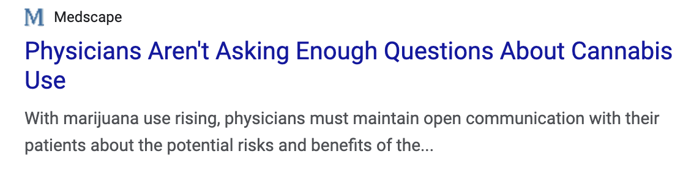
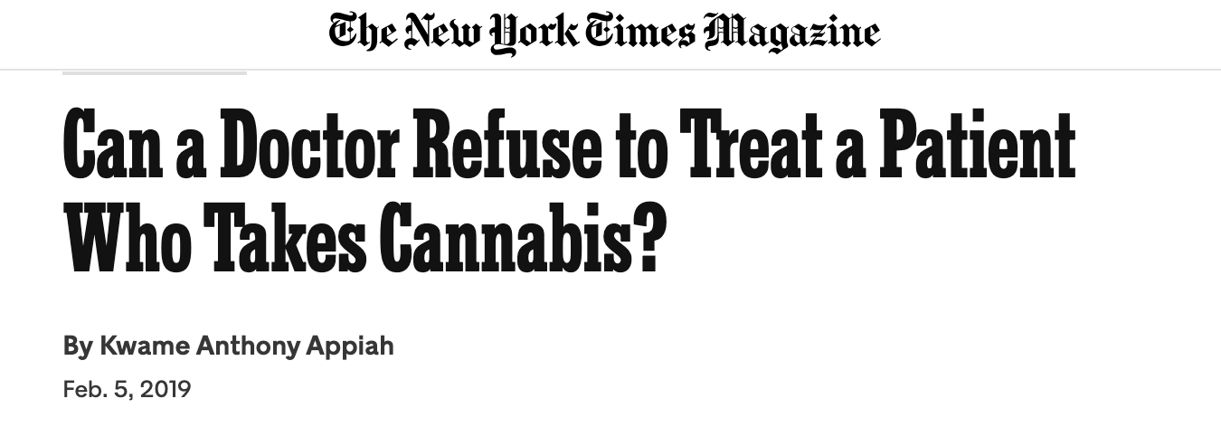
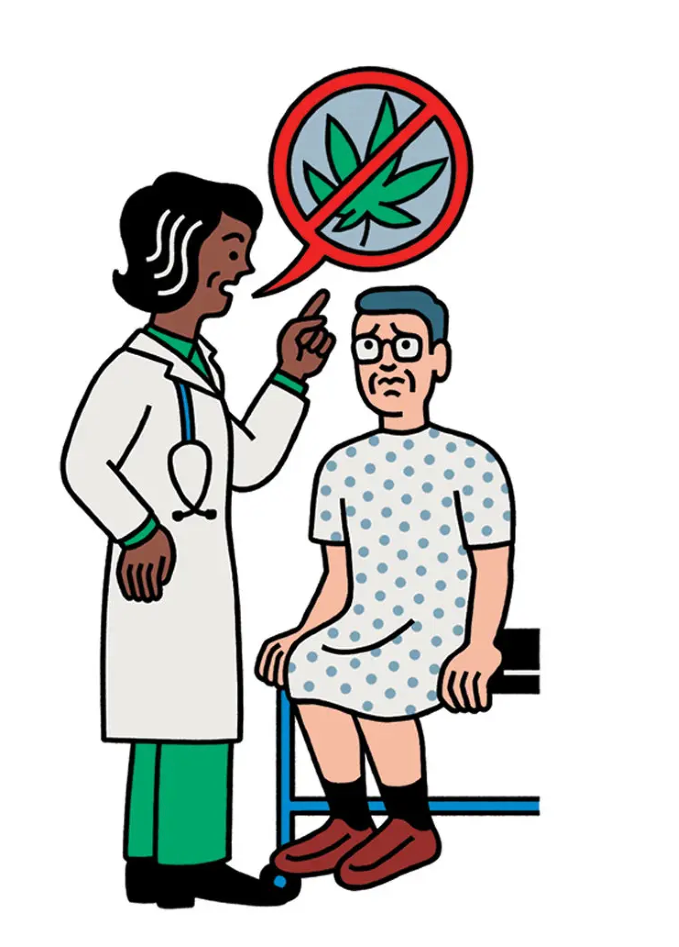
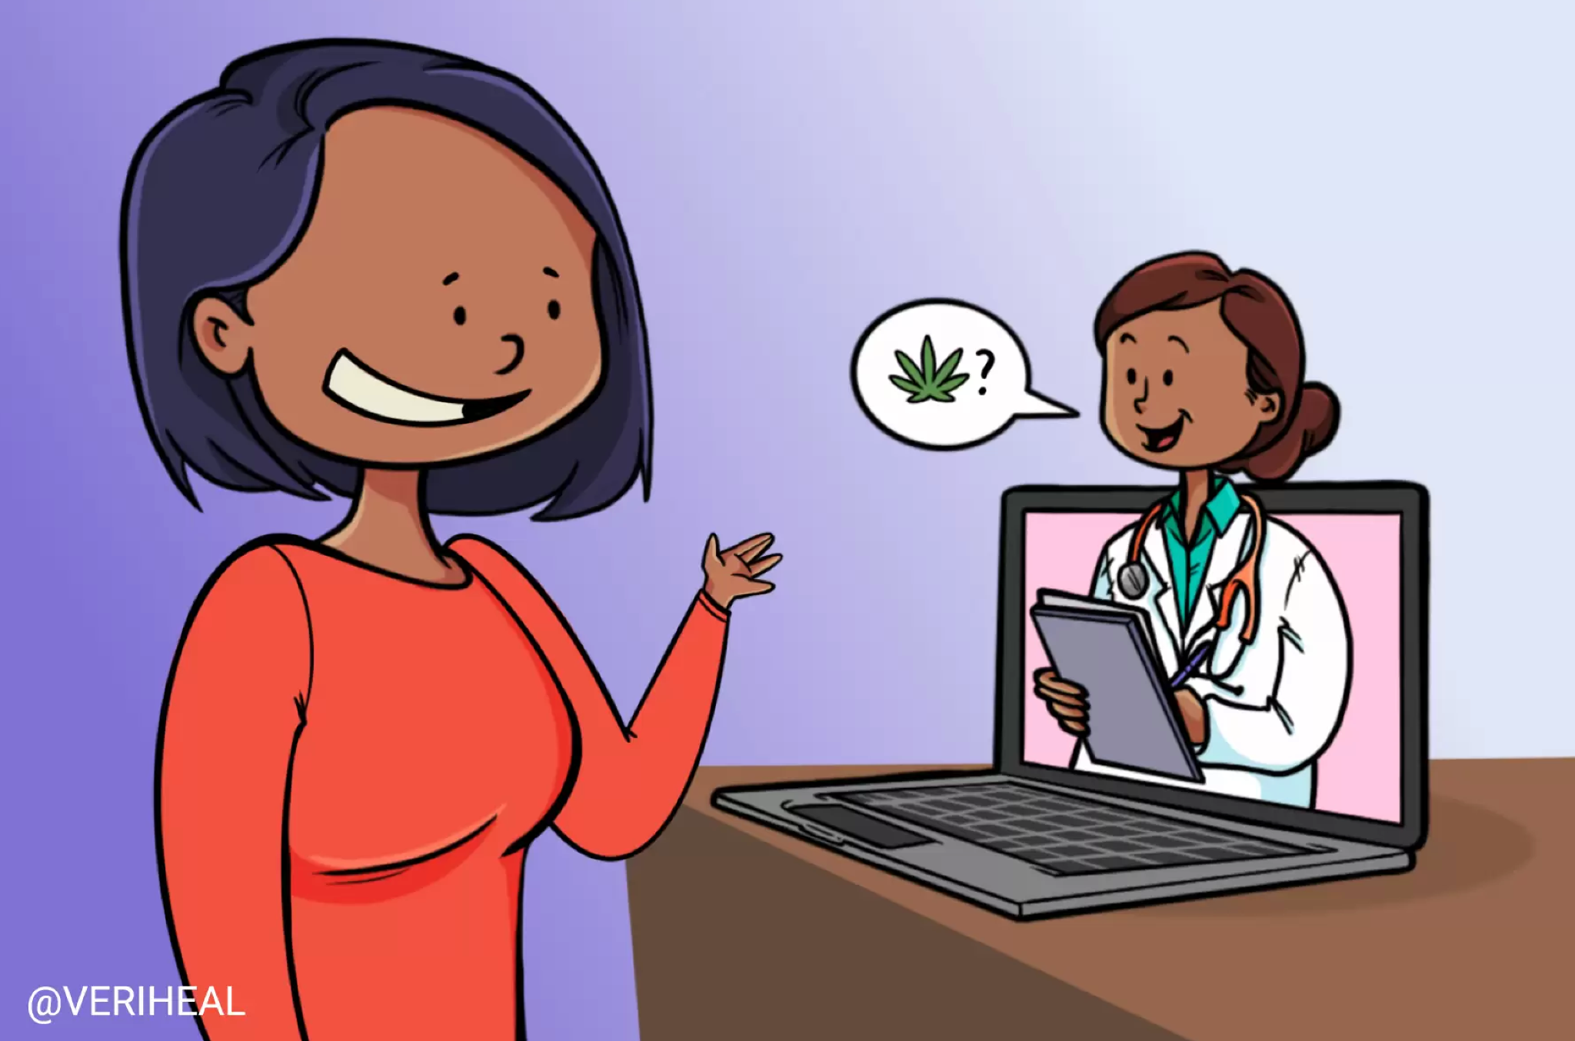
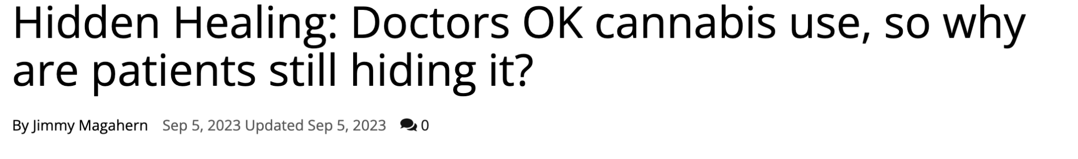
Implications for Practice
Rates of substance use are higher than previously known and the legal and social climate around cannabis is changing.
Providers and practices can:
  Implement universal screening for drugs and alcohol
  Work to destigmatize discussions about substance use
  Emphasize and teach effective contraceptive counseling
  Act as an informed resource for patients who have questions
Notes:
The results show that drug use rates are higher than we previously thought
Need for universal substance use screening and counseling during preventative appointments
Misconceptions about cannabis may contribute to unsafe usage- it is important to educate patients about health risks of cannabis use and discuss the importance of preventing substance-exposed pregnancies through effective contraception, especially as cannabis use becomes more widely accepted
It is important to destigmatize conversations about substance use in medical settings, as fear of negative consequences may prevent individuals using substances from disclosing substance use, which may perpetuate misconceptions and unsafe use. Destigmatizing conversations may help facilitate more effective patient-provider interactions about substance use
Emerging legalization may lead to uncertainty about how to advise clients about cannabis use
Understanding of the relationship between cannabis and other substance use
Challenges with polysubstance use reporting
Importance of contraceptive discussions to prevent AEPs
Destigmatize discussions about substance use in medical settings
Remove stigma, provide scripts, remove uncertainty for providers doing screening - this can be standard and routine
Rates of use are higher than previously understood - means that universal screening/su screening is important - prevention is through destigmatization of discussions of su and have these conversations + focus on contraception
Importance of universal/standardized substance use screening and counseling during preventative appointments
Misconceptions about the safety of cannabis may contribute to unsafe usage
Effective contraception counseling across PWVs - need to figure out to train providers to have more culturally appropriate conversations and interventions
Contraception counseling is important from a practice perspective
Substance use is high and continues to grow, so contraception discussions are important in preventing SEPs
Destigmatizing discussions about substance use in medical settings
Fear of negative consequences may contribute to a lack of transparency. Normalizing and destigmatizing conversations about substance use can allow for more effective interactions between patients and their providers
New legalization laws are challenging for providers/practitioners because guidance about cannabis use is changing
Education of providers regardless of geographical location and legal status of cannabis is important so that patients can be accurately educated/counseled around cannabis and polysubstance use

Slide 11
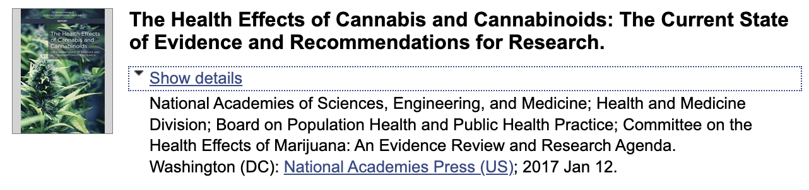




Directions for Further Research
Self-reporting measures in legal vs illegal states
Polysubstance use measures
Using biological markers as measures of substance use
Effects of cannabis use / polysubstance use during pregnancy
How can we train providers to offer evidence-based, culturally competent care?
Notes:
Use is higher than we previously thought - stigma remains an issue - as we train providers to implement universal screening and recommendations it is also worth thinking about how to train providers to be more culturally competent and confident when talking with patients who are both like and unlike them

Slide 12
Thank you
This work was supported by the US Department of Health and Human Services (DHHS), Centers for Disease Control and Prevention (CDC) NU84DD000005.
The content and findings in this presentation are those of the authors and do not reflect the official views of the CDC, DHHS, Planned Parenthood of the Great Northwest, Hawai’i, Alaska, Indiana, Kentucky, Planned Parenthood Federation of America, Inc., or UAA.

Slide 13
Legalization Status
Real differences in cannabis use
Self-Reporting
Stigma
Sociopolitical Climate

Slide 14
More Effective
Contraceptive methods that 88% or more effective at preventing pregnancy with perfect use.
Less Effective
Contraceptive methods that are less than 88% effective at preventing pregnancy with perfect use.
Classifying Contraceptives
Lifestyle: Menopause
Same-sex partner
Implant
Intrauterine Device
Sterilization (including partner)
Abstinence
Injection
Patch
Oral Contraceptive Pills
Ring
Lactational amenorrhea method
Condoms
Withdrawal
Natural family planning/fertility awareness
Spermicide
Barrier Method
Emergency contraception
None (seeking pregnancy)
Condoms
Barrier Method (diaphragm, sponge, etc)
Natural family planning/fertility awareness
Withdrawal
Spermicide
Emergency contraception
None (including ‘seeking pregnancy’)

