Slide 1

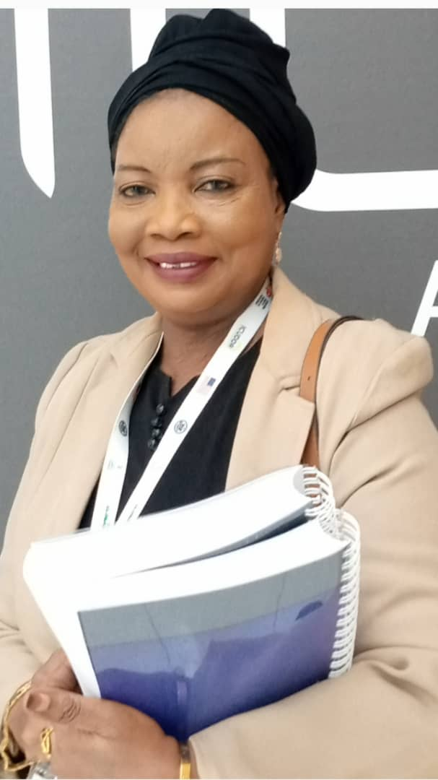
BRIEF INTERVENTION: QUALITATIVE STUDY OF EXTENT OF KNOWLEDGE AMONG HEALTH WORKERS IN PRIMARY HEALTH CARE CENTERS IN NIGERIA
FATIMA ABIOLA POPOOLA
COMMANDER OF NARCOTICS
NATIONAL DRUG LAW ENFORCEMENT AGENCY
ABUJA, NIGERIA
INEBRIA CONFERENCE
GREENSBORO, NORTH CAROLINA, USA
28TH-29TH SEPTEMBER 2023

Slide 2
BACKGROUND
The challenges of inadequate treatment centers and professionals in the field of Addiction necessitated the offspring of various non-professionals and unapproved treatment centers in the country.
The country’s health sector is also battling with inadequate funds to care for its various activities. Only 5.75 per cent of the total budget is allocated to the health sector in the 2023 proposed budget, although this is step further from the past allocation, it is not enough to solve the enormous health challenges of the country.

Slide 3
Issues arising from substance use are challenges being faced especially at the local communities.
With a prevalence rate of 14.3% of the population using drugs according to 2018 household survey
It is evident that there is a drug problem in Nigeria

Slide 4
Primary health care facilities which are the closest to the communities are almost not working due to the dilapidated structures and professional resources.
They are of a great help where there is the need for referrals for more severe case in more specialized health care services.
They are affordable, assessable and available in rural communities.

Slide 5
The primary health care system operates at the local community level to cater for health issues that are not emergencies in nature; it serves as a first point of call to prevent and manage health issues within the community.
The Primary health care centers serve the individuals and families within the communities.

Slide 6
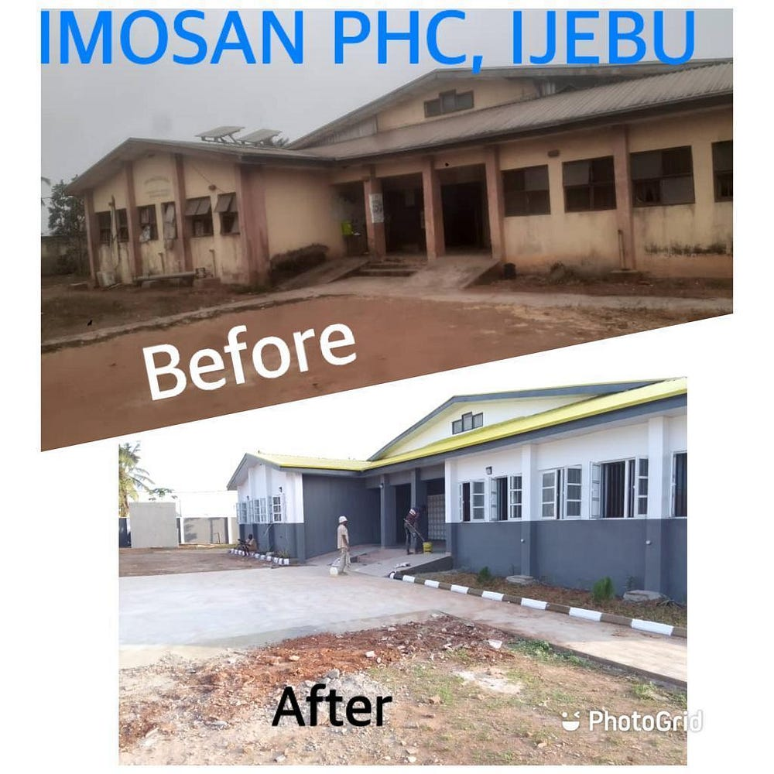
Picture Showing the Dearth of a Primary Health Care Center and efforts to make them work in some parts of Nigeria

Slide 7
RATIONALE
The last household survey of 2018 in Nigeria indicated about 14.3% representing 14.4 million people between the ages of 15-64 years have used drugs in the past year.
This is higher than the 2015, 5% global prevalence of 5.6%
The need to face the reality of the extent of drug use and to help people who have little or no issues concerning their substance use.

Slide 8
The need for primary health care workers to help drug users in the communities and make referrals where necessary.
To assess the extent of knowledge of Brief Intervention among health workers within the communities.
To determine areas where policy makers could help the community by training PHC workers on Brief Intervention

Slide 9
METHODS OF DATA COLLECTION
Semi-structured and self-administered questionnaires with open and closed options were used to obtain demographic data of the participants
Semi structured Interview method was also used to collect information from the participants.

Slide 10
The contents of the questionnaire covered the following: Section A: Bio-data of the study participants and working experience while Section B covers: Knowledge of Screening, Brief Intervention and Referral Treatment.
The respondents gave their consent to participate in the study. The participants were guided through each session of the interview and questionnaires.

Slide 11
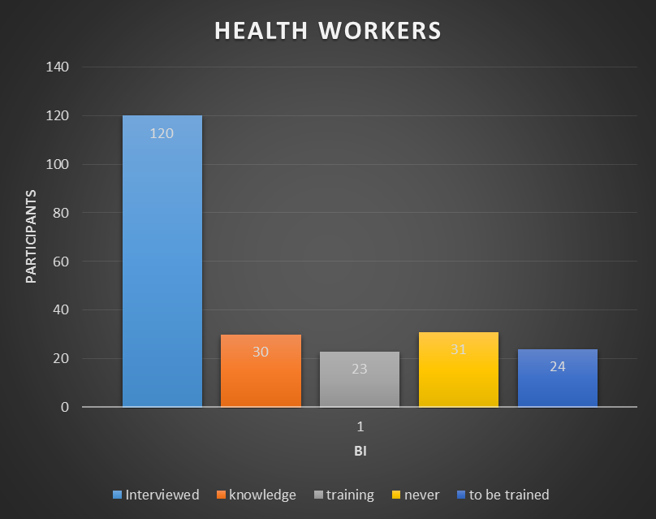
ANALYSIS AND RESULTS

Slide 12
CONCLUSION
This study shows that health workers at the local communities are the first contact to provide first aid in the case of health emergencies
They are the first to recognize and diagnose early symptoms of sickness
They are capable of making referrals where necessary

Slide 13
CONCLUSIONS CONTD.
They can detect signs and symptoms of substance use and could be helpful in providing brief intervention where necessary
With more awareness, they can help the local communities to reduce the impact of substance use in the rural areas

Slide 14
More training is required among these health workers to improve brief intervention services within the communities.

Slide 15
                THANK YOU

